Slide 1
Journey to a Cashless Society
Presented by: Justin Chan

Slide 2
Contents
Background to ‘The Cashless Society’ Working Party
Evolution from Cash to Cashless
Cashless Journeys
Sweden, China, Singapore, Malaysia
Issues arising from a Cashless Society

Slide 3
Background to ‘The Cashless Society’ Working Party
Part of IFoA’s Finance and Investment Research Working Parties
Established late 2016
Diverse members across various countries, one non-actuary
Published several papers:
“A Cashless Society – Risk, Benefits and Issues”
“The Rise and Rise of Quick Response (QR) Codes”
“A Cashless Society – Environmental Sustainability of a Cashless Society”

Slide 4
Background to ‘The Cashless Society’ Working Party
Part of IFoA’s response to:
HM Treasury Cash and Digital Payments in the New Economy
Treasury Committee Inquiry into Consumers’ Access to Financial Services
Payment Systems Regulator’s Research into Cash Access, Use and Acceptance
Website
https://www.actuaries.org.uk/practice-areas/finance-and-investment/finance-and-investment-research-working-parties/cashless-society-working-party

Slide 5
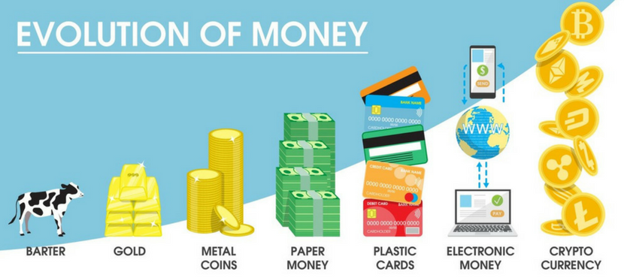
Evolution from Cash to Cashless
Ref [2]
What factors are driving these changes?

Slide 6

Sweden

Slide 7
Sweden
Background (Ref [1][2])
23 Sept 2009 - Västberga Heist
High profile robberies led to Swedish Bank Tellers’ Union lobbying against handling cash
Bus drivers were attacked for their fares
Swedish banks realised it was more profitable to use fee-inclusive transaction technologies (eg. debit card, credit card) than to handle cash
Result
Sweden is largely considered the most ‘Cashless Society’ in the world
In 2017, cash transactions made up only 2% of the value of all payments
900 of Sweden’s 1600 bank branches no longer keep cash on hand or take cash deposits

Slide 8
Sweden
Push back (Ref [3][4][5])
Fraudsters exploited loopholes in the system to trick people of their money/pensions
Concern of an invading Russia taking over by switching off the payment systems
Financial exclusion of rural areas, elderly and vulnerable
Concern of a small number of commercial entities being responsible for payments
March 2018 opinion poll
70% of Swedes want the option of using cash
25% want a completely cashless society
Swedish Central Bank proposal
mandatory for banks to offer cash withdrawals and handle daily receipts (of cash)

Slide 9
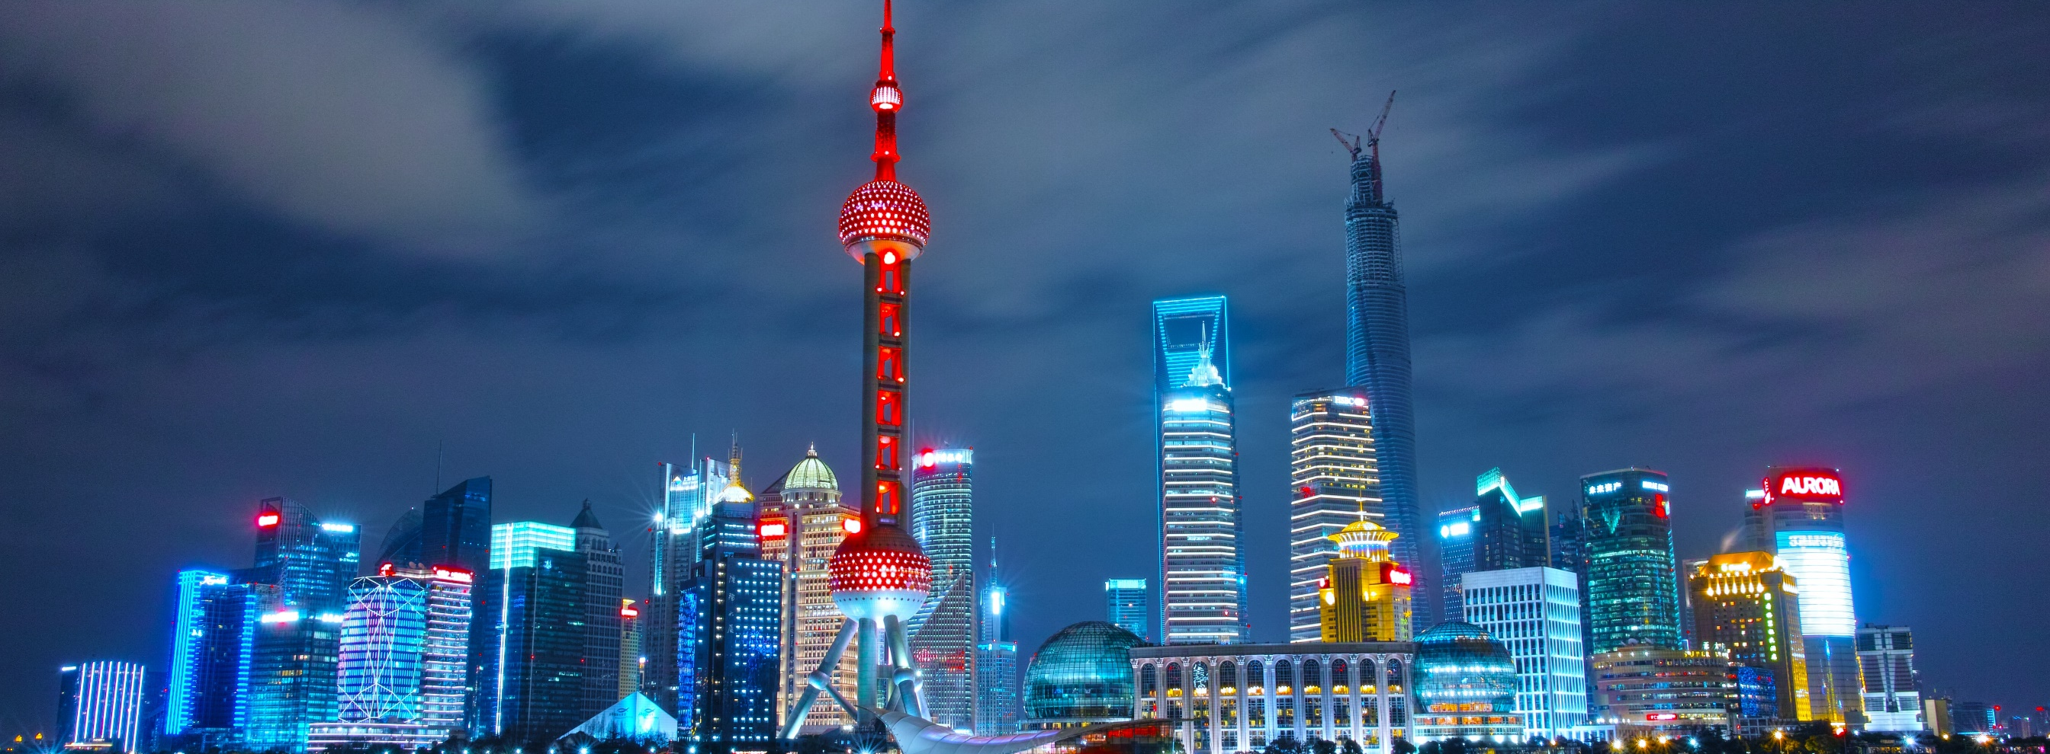
China

Slide 10
China
Development and commercialization of advanced technologies
Mobile hardware companies
Huawei
2nd largest mobile manufacturer (after Samsung)
Mobile networking equipment, 5G technology
Tech companies
Alibaba Group, Tencent, JD.com, Baidu
Observations
Dealing with failure – move quickly and integrate another new system.
Continuous learning!

Slide 11
China
Social Credit System (Ref [7])
National reputation system developed by Chinese government
Initiated in 2014 and expected to be largely operational in 2020
2015 - Licensed 8 companies to trial this (including Sesame Credit, Tencent)
Purpose: Standardize the assessment of citizens’ and businesses’ economic and social reputation
Penalized for dishonest and fraudulent financial behaviour, playing loud music, jaywalking
Punishments include travel ban (eg. rail, flights),
Rewarded for donating blood, donating to charity, volunteering for community service
Rewards include: easier access to credit loans, discounts for cars, free health check-ups

Slide 12
China
Great Firewall of China (Ref [6])
Supported by large population – 700 million internet users
Allows for growth of local internet giants – Tencent, Alibaba
China | Outside China
Tencent Video | YouTube
Baidu | Google
WeChat | WhatsApp
Tencent Weibo | Twitter
Alibaba | Amazon

Slide 13
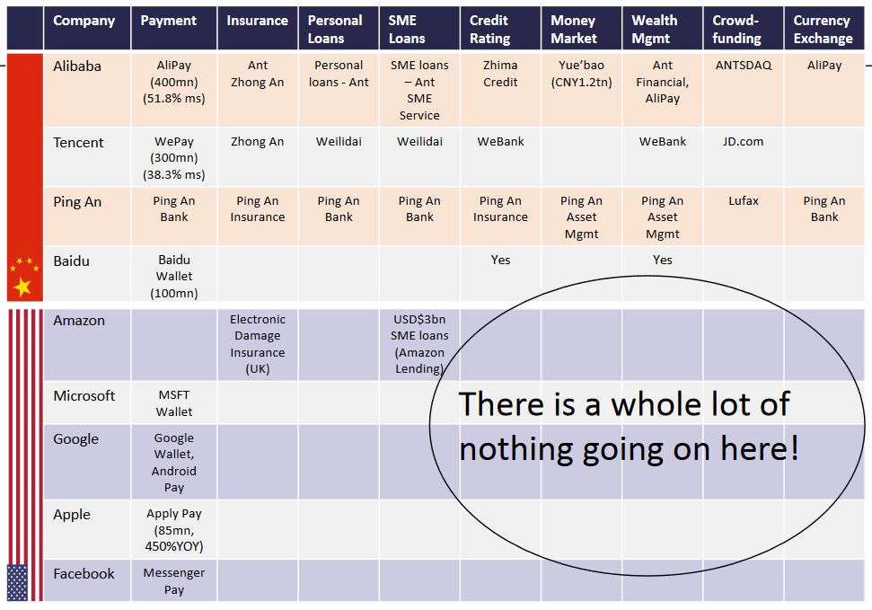
Ref [9]

Slide 14
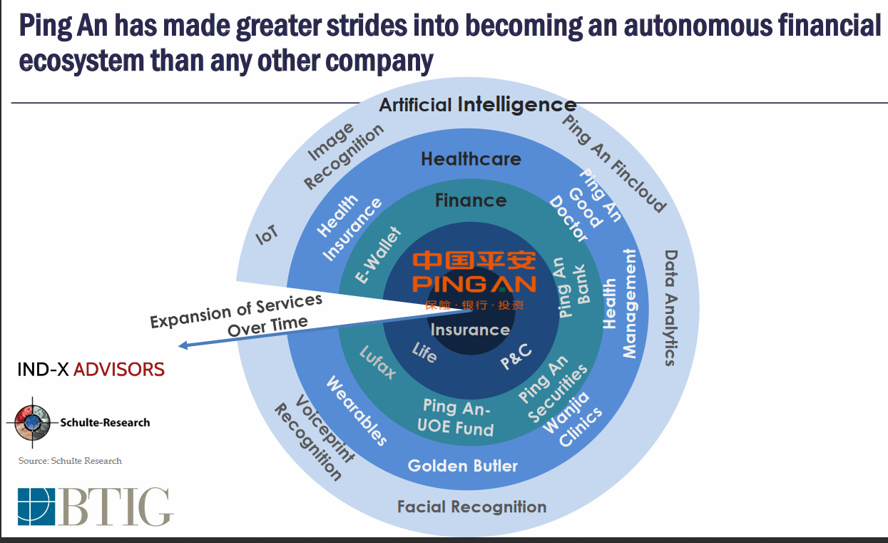
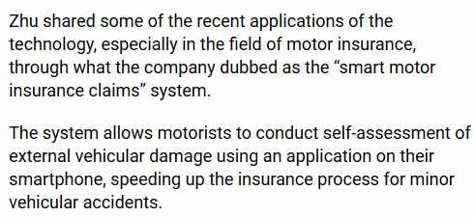
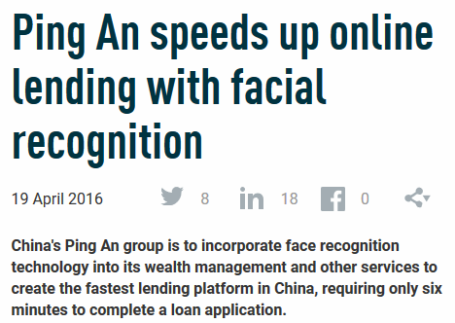
Patient-Doctor Meeting Schedule
Ref [8] [9] [10] [11]

Slide 15
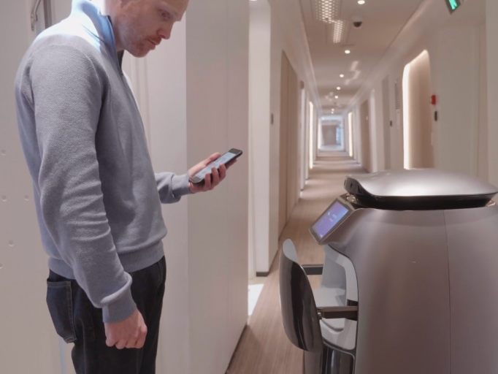
China
Cashless and Cashierless – Unmanned Provision Shops (Ref [12])
Similar to Amazon Go
Multiple technologies – sensors, mobile, facial recognition
Estimated ~200 unmanned stores in end 2017, but two years later, many are now closed
Other automated stores
Shop with robots making bubble tea [13]
Alipay – unmanned clothing store in Hong Kong [14]
Alibaba’s ‘Hotel of the Future’ in Hangzhou – FlyZoo [55]
Make reservations and payments entirely from mobile app
Enter room using facial recognition system; Robots serve food, toiletries etc.

Slide 16
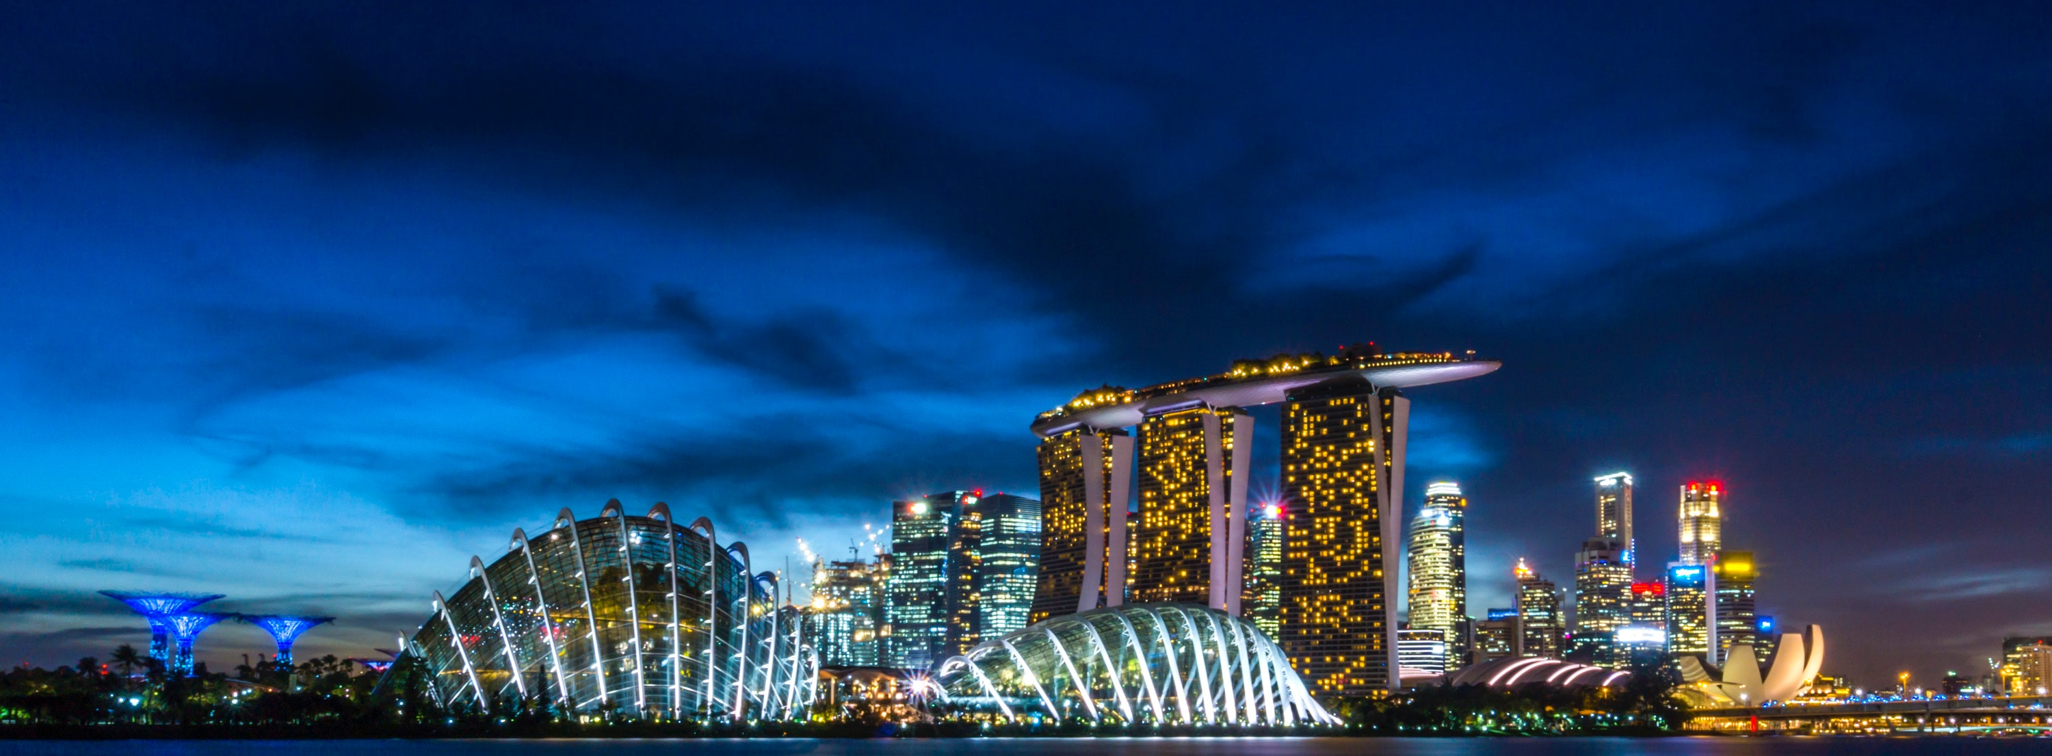
Singapore

Slide 17
Singapore
Traditional cashless solutions
Translink Farecard / Ezlink Card
Cashcard for Electronic Road Pricing (ERP), public parking
Nets
Credit card
Cheques
Telegraphic Transfers
GIRO
Not based on mobile apps, QR codes

Slide 18
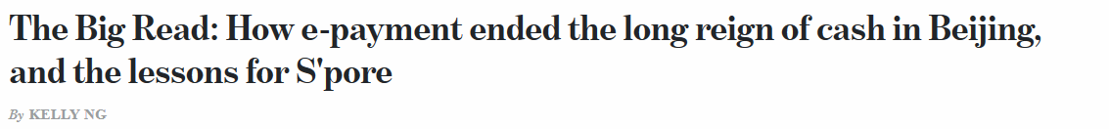
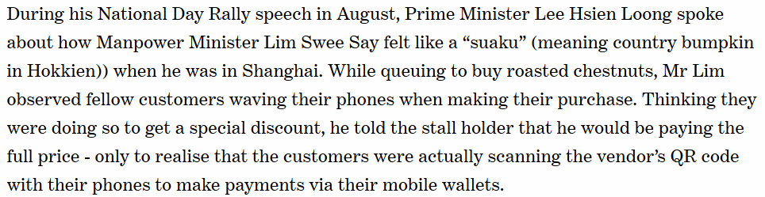
Singapore
And then this happened…
Ref [16]

Slide 19
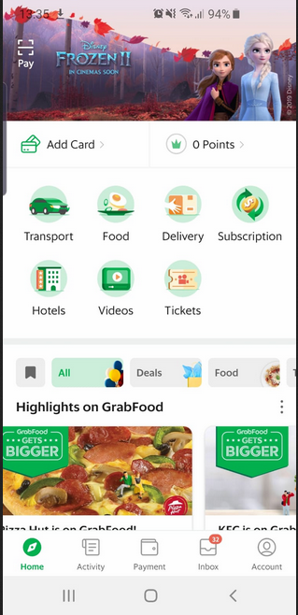
Singapore
New Fintech Solutions
Mobile Apps
Paylah, PayNow - electronic payments via mobile number, QR codes
Grab – ride-hailing, food, delivery, video etc.
Contactless Payment
ApplePay, SamsungPay – biometric security
Contactless Credit Card - Paywave
Common QR Codes – standardisation
Lively Fintech Scene
PolicyPal, Stripe

Slide 20
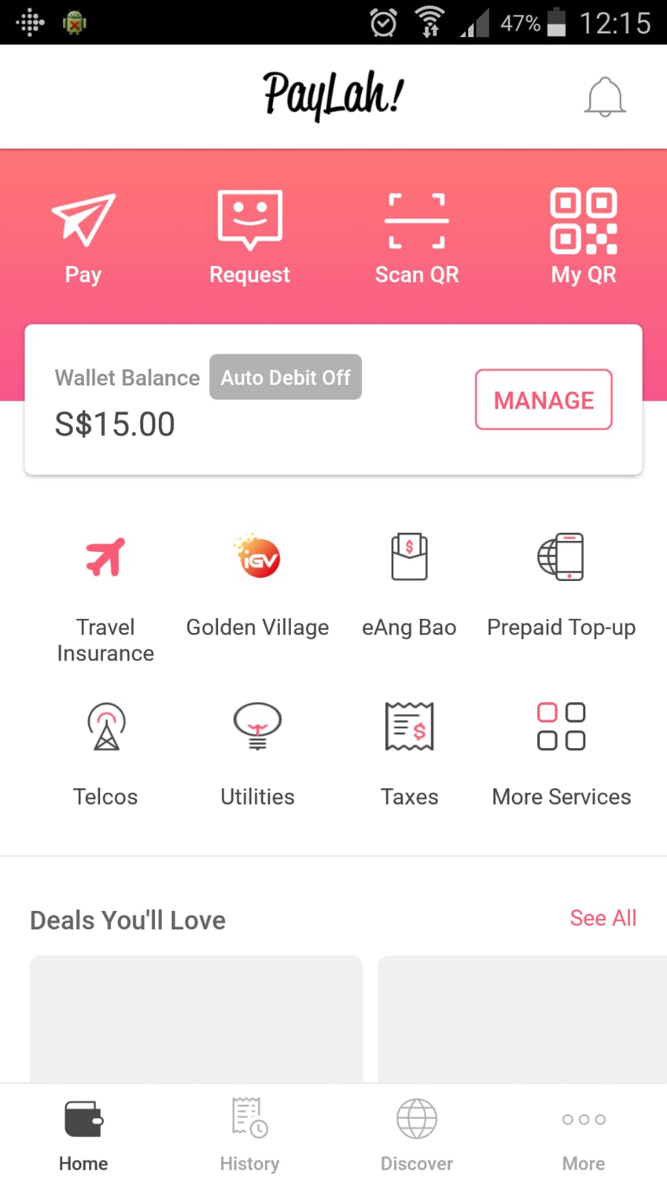
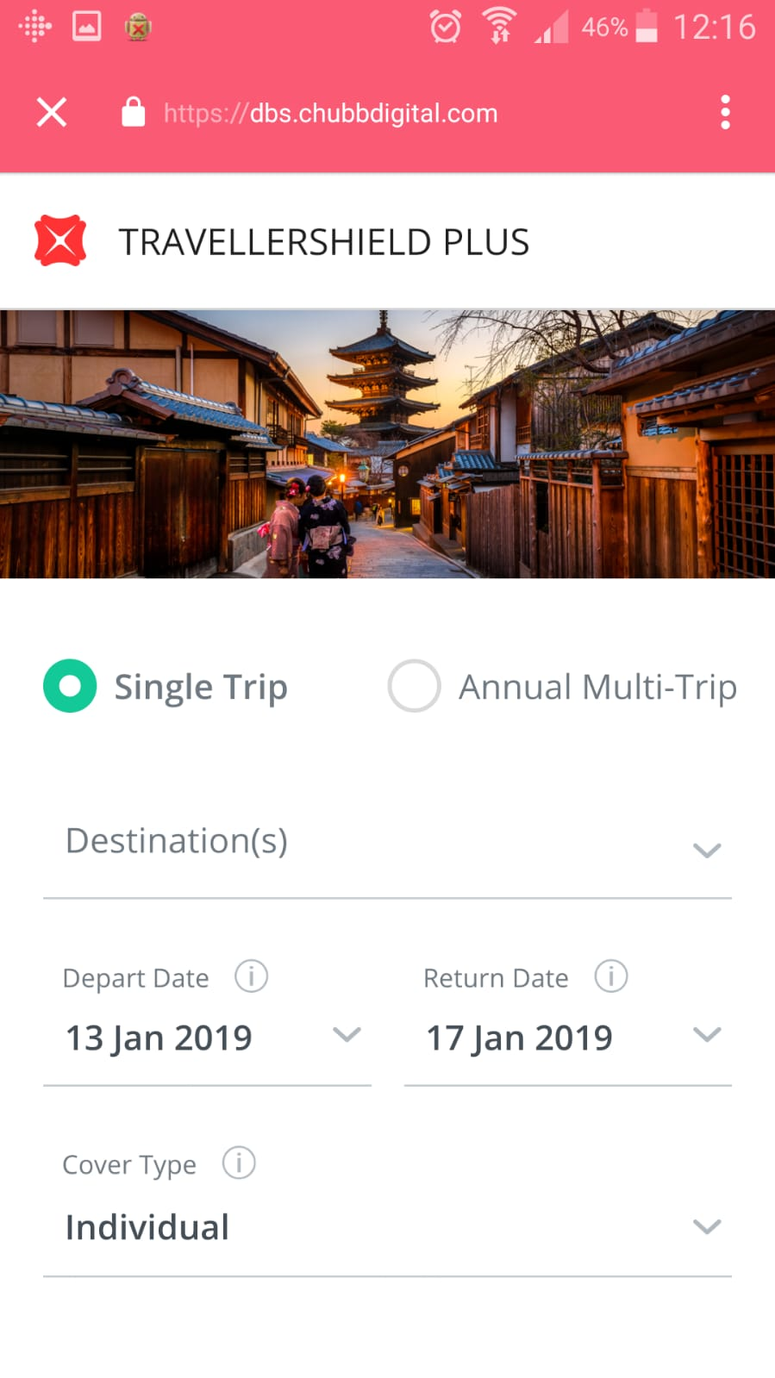
Singapore
Redirect to Insurer’s Website
All-in-one Platforms - Mobile Super Apps
Strategic Partnerships
Utility Companies, Government etc.
Understand customer lifestyle and payments
Transport, travel, food, bills
Offer deals, convenience and security
Insurer’s consideration
Omni-channel marketing
Underwriting considerations
Opportunity to obtain marketing consent
Upsell and cross-sell opportunities

Slide 21
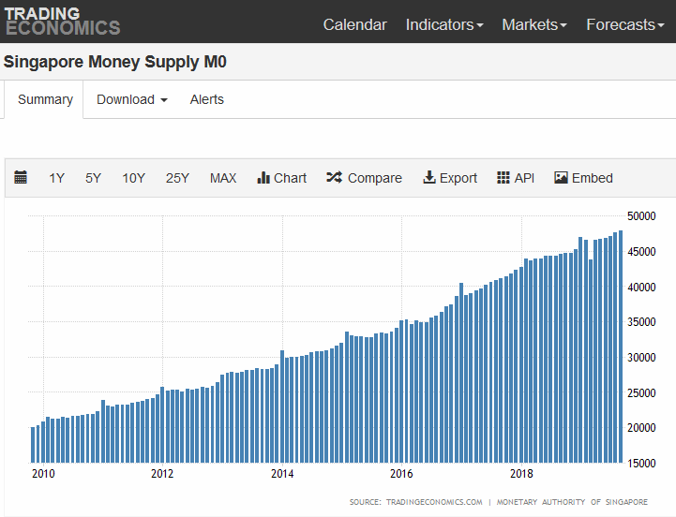
Singapore
Going more cashless
Yet cash supply is still increasing over time…
Ref [17]

Slide 22
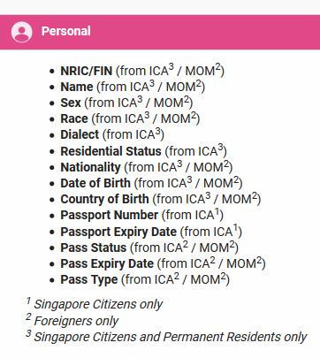
Singapore
Security Breaches and Protecting Singaporean’s Data
Singhealth Data Breach [18]
1.5 million non-patient records, including PM Lee.
MyInfo – Personal Data Platform [19]
Run by Singapore Government
Can be used to apply for bank accounts, insurance policies etc.
Provides access to personal information, income, CPF savings etc.
Convenience – Reduced form-filling and errors
From 1 Sept 2019, illegal for organisations to collect, use or disclose NRIC numbers [20]

Slide 23
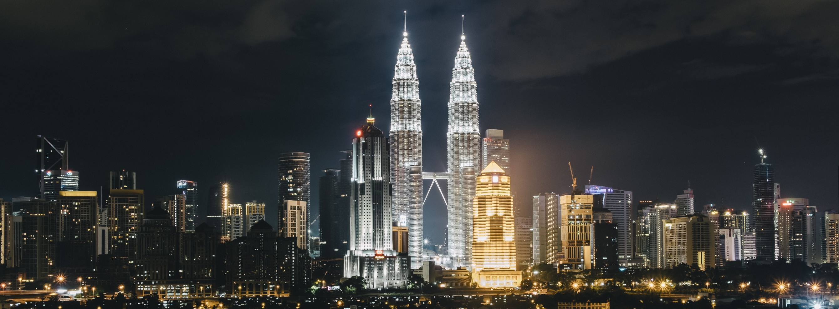
Malaysia

Slide 24
Malaysia
Strong government push for a cashless society
Financial Sector Blueprint 2011-2020
Targets to increase e-payments per capita from 44 to 200 transactions [21]
Currently 124.6 transactions [21]
Reduce cheques by more than half (currently ~101 mil cheques in 2018 vs 204.9 mil in 2011) [21]
Government to provide RM30 to e-wallet users aged 18 and above, earning less than RM100,000 annually [22]
Malaysians still prefer cash [21]
Concern over security of e-wallets

Slide 25
Malaysia
Commercially success digital payments platforms
Boost [22]
Partners with 113,000 merchants (eg. Mydin, Tesco, Giant, KFC)
Pay for utilities, parking, buy prepaid top-ups, public transport
60% of merchants are small and micro-enterprises, primarily cash-based
Partnership with UnionPay – huge Chinese tourist market [24]
Competitive environment
Vcash is dead [K3]

Slide 26
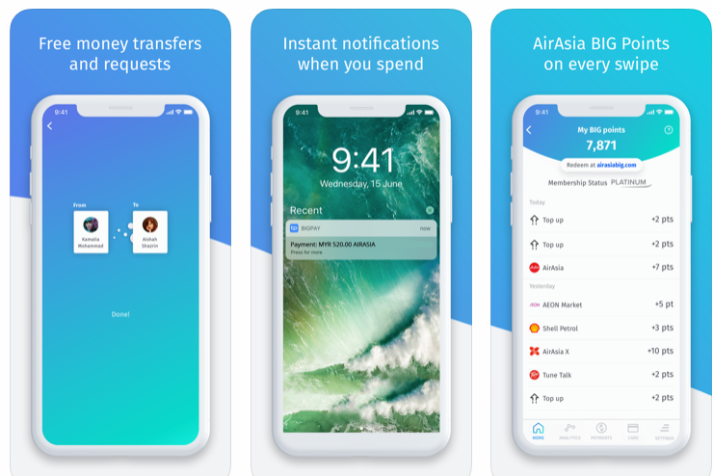
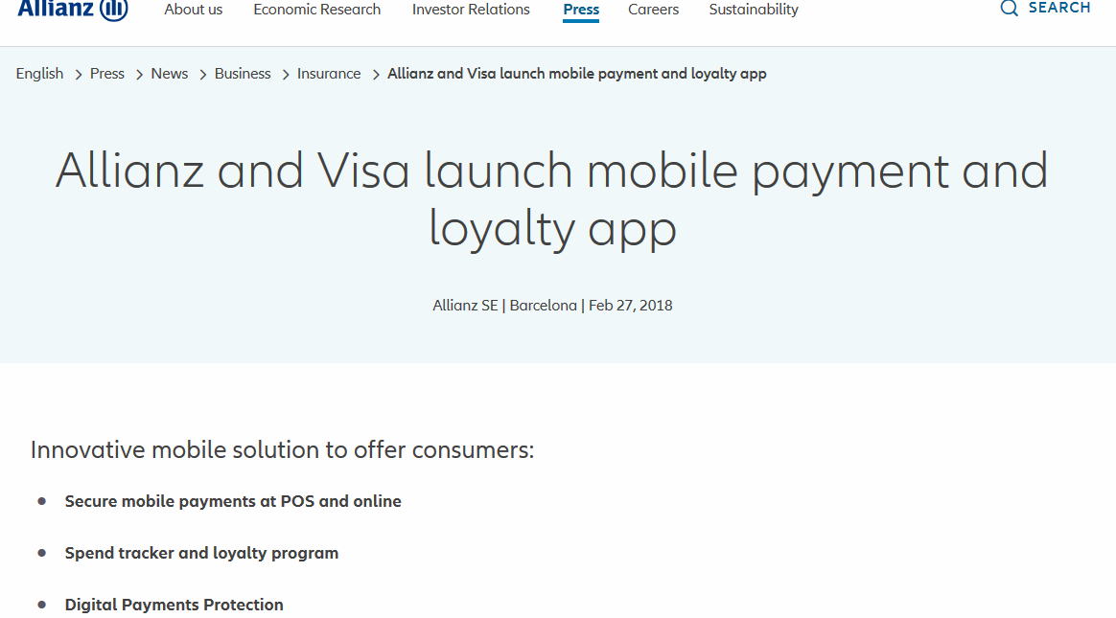
Malaysia
AirAsia’s BigPay [25][26]
Sign-up through smartphone
Issue of Mastercard that can be used worldwide
Lower processing fee
Send money - International Remittance Service
Potentially worth more than the airlines in future
Insurers are slower to move in this space [27]

Slide 27
Issues arising from a Cashless Society
Cybercrime and cybersecurity
From local robbers to global hackers
Data breaches can lead to identity theft, blackmail, financial losses
Privacy
Data harvesting online and offline
Digital marketing – behavioural manipulation, sharing of data amongst firms
Resilience of digital payment systems to operational failure
Power loss, equipment failure, network failure
Would a diverse financial ecosystem of money and payment systems be more resilient?

Slide 28
References
[1] Collier, I. et al., 2017. A Cashless Society – Benefits, Risks and Issues (Interim Paper). Institute and Faculty of Actuaries, UK, 2017
https://www.actuaries.org.uk/practice-areas/finance-and-investment/finance-and-investment-research-working-parties/cashless-society-working-party
[2] Marcelo, Cashless future, Medium, 22 Sep 2018
https://medium.com/predict/cashless-future-1e240d287717
[3] David Crouch, ‘Being cash-free puts us at risk of attack’: Swedes turn against cashlessness, The Guardian, 3 Apr 2018
https://www.theguardian.com/world/2018/apr/03/being-cash-free-puts-us-at-risk-of-attack-swedes-turn-against-cashlessness
[4] Amanda Billner, In Shadow of Facebook, Cashless Sweden Fears Data Privacy Risks, Bloomberg, 22 Mar 2018
https://www.bloomberg.com/news/articles/2018-03-22/in-shadow-of-facebook-cashless-sweden-fears-data-privacy-risks
[5] Ryan Browne, People in Sweden barely use cash — and that’s sounding alarm bells for the country’s central bank, CNBC, 3 May 2018
https://www.cnbc.com/2018/05/03/sweden-cashless-future-sounds-alarm-bells-for-the-central-bank.html

Slide 29
References
[6] Wikipedia, Great Firewall, https://en.wikipedia.org/wiki/Great_Firewall
[7] Wikipedia, Social Credit Systemhttps://en.wikipedia.org/wiki/Social_Credit_System
[8] Paul Schulte and David Lee Kuo Chuen, AI & Quantum Computing for Finance & Insurance, World Scientific, 2019
[9] Paul Schulte, Asia Independent Research Conference, Schulte Research, 2018
https://www.aima.org/uploads/assets/uploaded/0e42bd7b-a90f-4628-8bf093792c937095.pdf
[10] Gabriel Olano, AI to be more deeply integrated into insurance – Ping An, Insurance Business Asia, 5 Nov 2019
https://www.insurancebusinessmag.com/asia/news/breaking-news/ai-to-be-more-deeply-integrated-into-insurance--ping-an-190507.aspx
[11] Finextra, Ping An speeds up online lending with facial recognition, 19 Apr 2016
https://www.finextra.com/newsarticle/28756/ping-an-speeds-up-online-lending-with-facial-recognition

Slide 30
References
[12] Hiroshi Murayama, China's unmanned store boom ends as quickly as it began, Nikkei Asian Review, 17 Jun 2019
https://asia.nikkei.com/Business/Business-trends/China-s-unmanned-store-boom-ends-as-quickly-as-it-began
[13] Daisuke Hara Shima, Automated shops spread in China as mobile payments take off, 7 Jun 2018
https://asia.nikkei.com/Business/Business-trends/Automated-shops-spread-in-China-as-mobile-payments-take-off
[14] Takeshi Khara, Alipay opens unmanned apparel shop in Hong Kong, 7 Sep 2018
https://asia.nikkei.com/Business/Companies/Alipay-opens-unmanned-apparel-shop-in-Hong-Kong
[15] Bethany Biron, Chinese e-commerce giant Alibaba has a hotel run almost entirely by robots that can serve food and fetch toiletries — take a look inside, Business Insider US, 21 Oct 2019
https://www.businessinsider.sg/alibaba-hotel-of-the-future-robots-ai-2019-10/?r=US&IR=T

Slide 31
References
[16] Kelly Ng, The Big Read: How e-payment ended the long reign of cash in Beijing, and the lessons for Singapore, Today Online, 27 Sep 2017 https://www.todayonline.com/singapore/big-read-beijing-cash-not-king-and-mobile-payment-reigns-supreme
[17] Trading Economics, Singapore M0 Money Supply, 24 Nov 2019
https://tradingeconomics.com/singapore/money-supply-m0
[18] Kevin Kwang, Singapore health system hit by ‘most serious breach of personal data’ in cyberattack; PM Lee's data targeted
, Channel News Asia, 20 Jul 2018
https://www.channelnewsasia.com/news/singapore/singhealth-health-system-hit-serious-cyberattack-pm-lee-target-10548318
[19] Singapore Government, MyInfo : https://www.singpass.gov.sg/myinfo/intro
[20] Hariz Baharudin, Collecting NRIC numbers and making copies of the identity card will be illegal from Sept 1, 2019
, Straits Times, 31 Aug 2018
https://www.straitstimes.com/singapore/collecting-nric-numbers-and-making-copies-of-the-identity-card-will-be-illegal-from-sept-1\

Slide 32
References
[21] The Star Online, Fitch Solutions: Malaysians still prefer cash to cashless transactions, 31 Jul 2019
https://www.thestar.com.my/business/business-news/2019/07/31/fitch-solutions-malaysians-still-prefer-cash-to-cashless-transactions
[22] The Star Online, Towards a Cashless Malaysia, 13 Oct 2019
https://www.thestar.com.my/news/nation/2019/10/13/towards-a-cashless-malaysia
[23] vernonchan.com, Malaysia’s pioneer e-wallet vcash is dead, 31 Oct 2019
https://vernonchan.com/digi-vcash-ewallet-shut-down/
[24] Soumik Roy, Can e-wallet partnerships help UnionPay drive Malaysia’s digital economy?, 21 Nov 2019
https://techwireasia.com/2019/11/can-e-wallet-partnerships-help-unionpay-drive-malaysias-digital-economy/

Slide 33
References
[25] Straits Times, AirAsia in talks to build mobile app that will sell more than plane tickets, 27 Feb 2018
Accessed 24 Nov 2019: https://www.allianz.com/en/press/news/business/insurance/180227-allianz-visa-launch-mobile-payment-and-loyalty-app.html
[26] CNBC, AirAsia CEO says its mobile payment app will give Alipay, GrabPay ‘a run for their money’, 6 Nov 2018
Accessed 24 Nov 2019: https://www.cnbc.com/2018/11/06/airasia-ceo-bigpay-can-give-alipay-grabpay-a-run-for-their-money.html
[27] Allianz, Allianz and Visa launch mobile payment and loyalty app , 27 Feb 2018
Accessed 24 Nov 2019: https://www.allianz.com/en/press/news/business/insurance/180227-allianz-visa-launch-mobile-payment-and-loyalty-app.html

